Slide 1
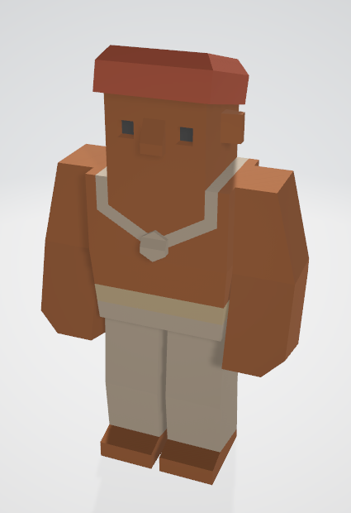
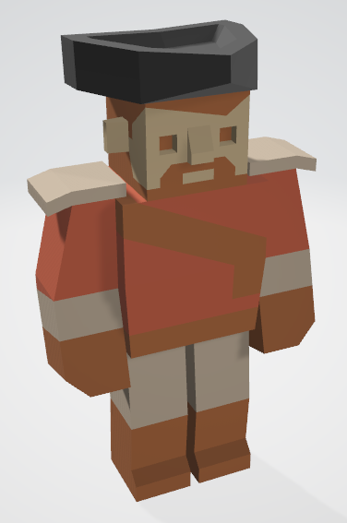
Level 6 – Group 3
Ship Happens
Tom Gibbs
Henry Crofts

Slide 2
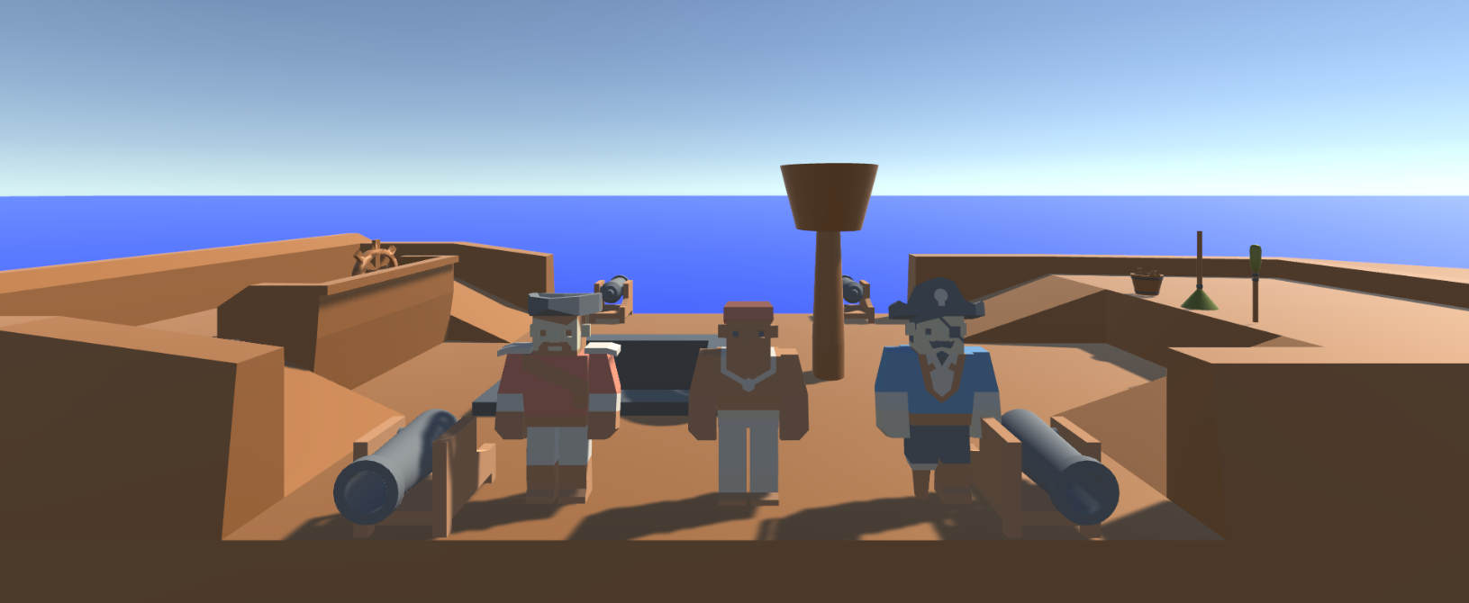
Logline
Local coop resource management game where players must coordinate to resolve hazards and manage activities, figuring out the optimal strategy

Slide 3
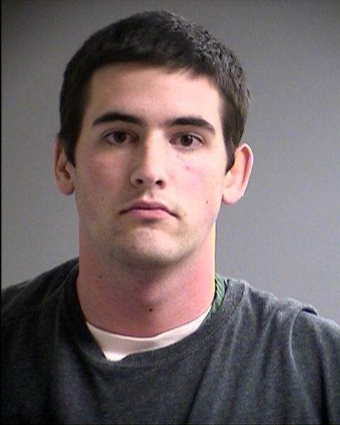
Psychographic
Terry Goldhorn
Aspiring Personal Trainer
Goal oriented / Targets / Progression
Social, plays games and goes out with friends
Student 20 y/o – Sport Sciences
Shared Accommodation
Morning Run / Lectures / Work / Evening Downtime

Slide 4
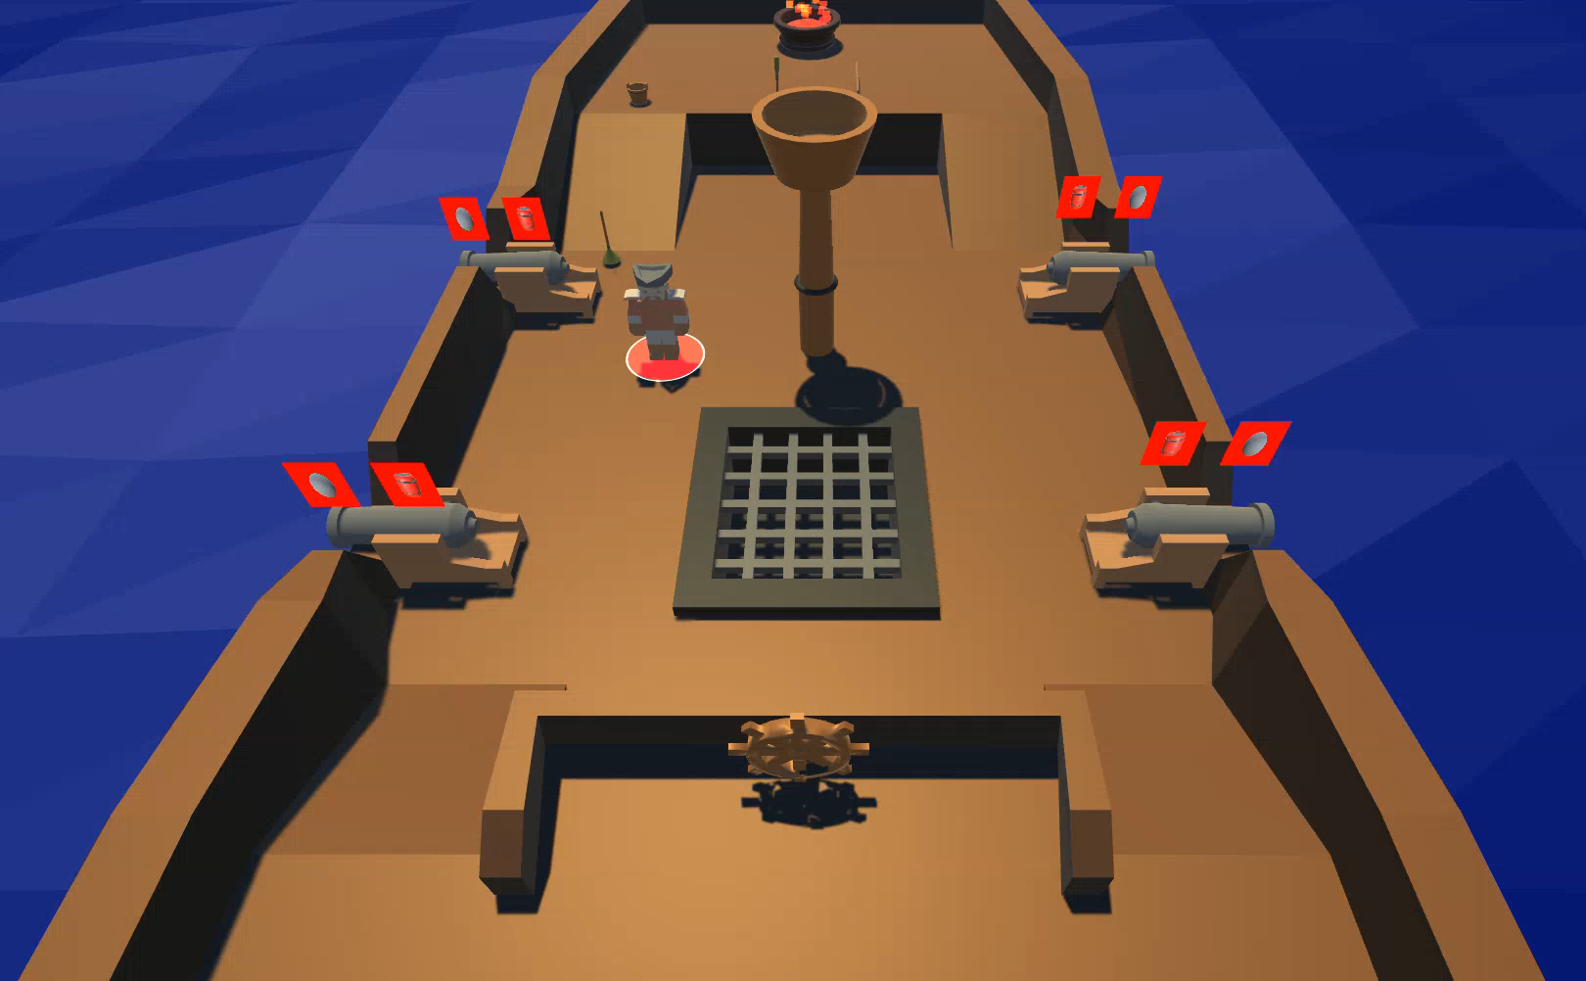
Ship Hold: Retrieve items

Slide 5
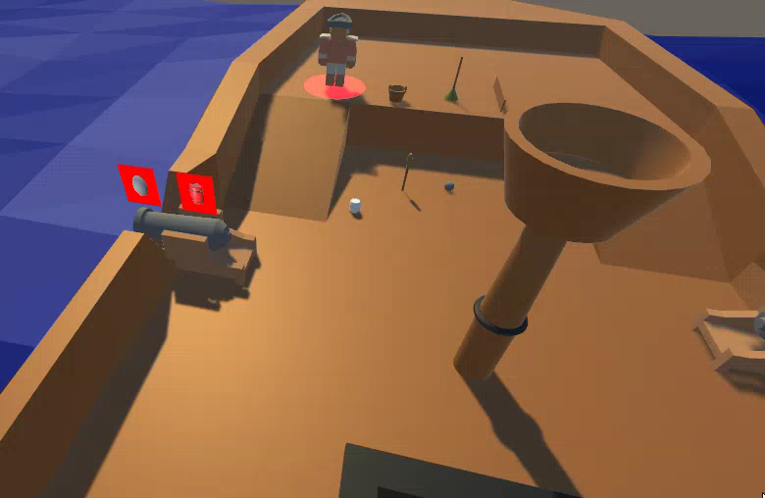
Cannon & UI

Slide 6
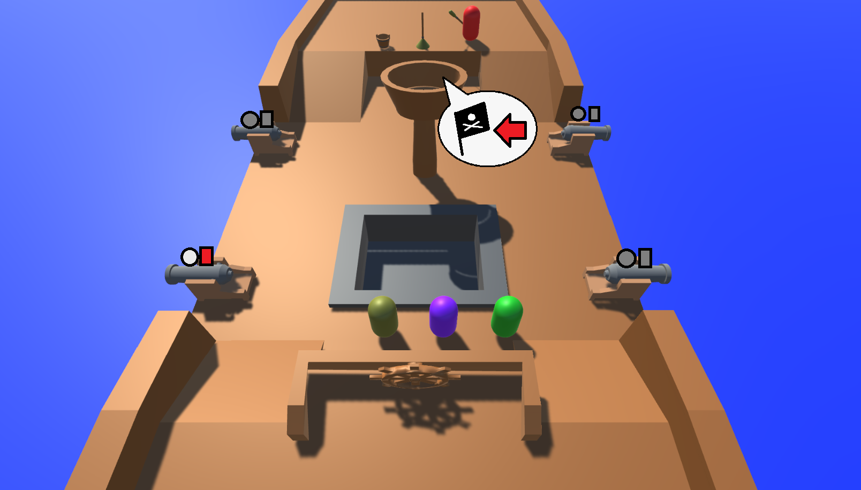
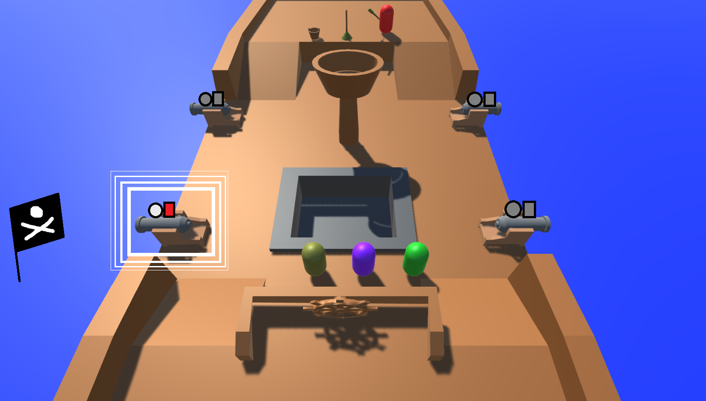
Showing Enemy Location

Slide 7
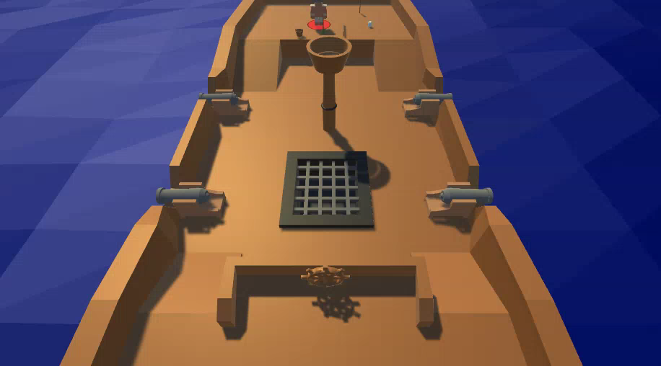
Enemy Cannon Fire

Slide 8
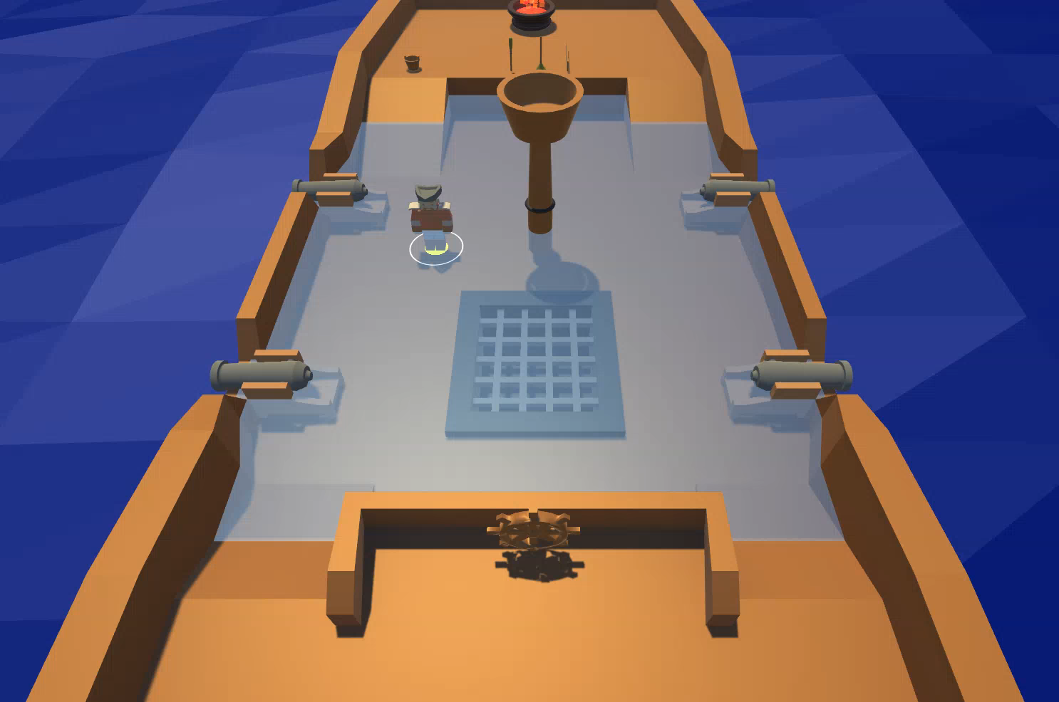
Bail Water

Slide 9
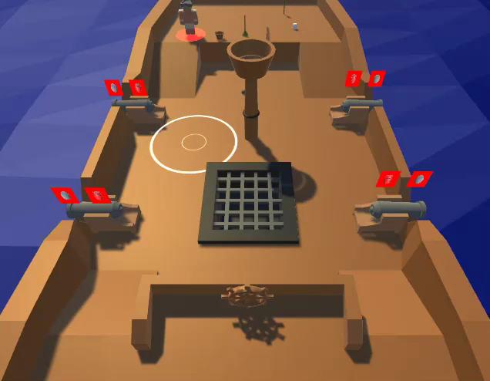
Repairing The Deck

Slide 10
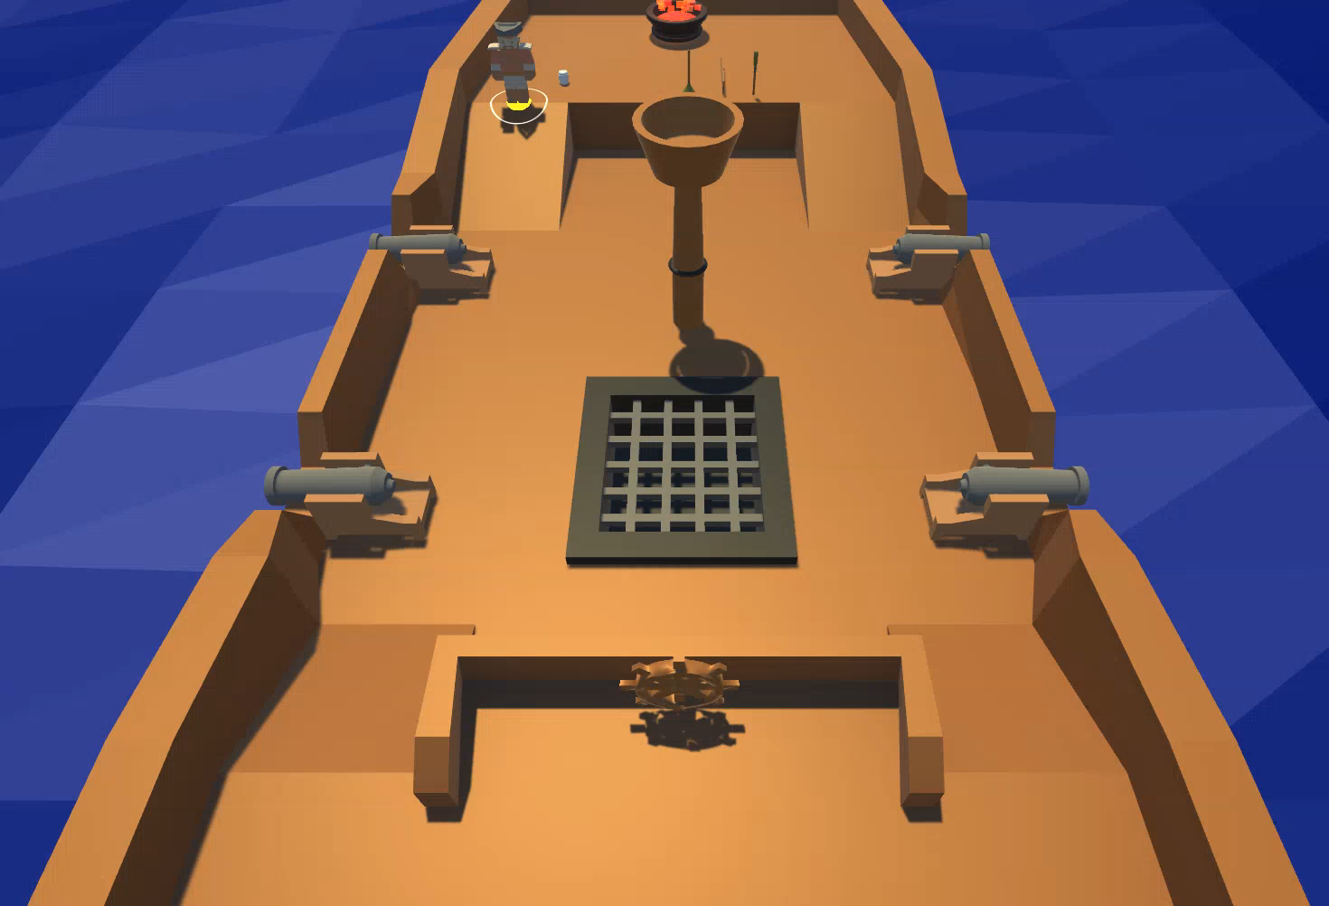
Crow’s Nest Call Outs

Slide 11
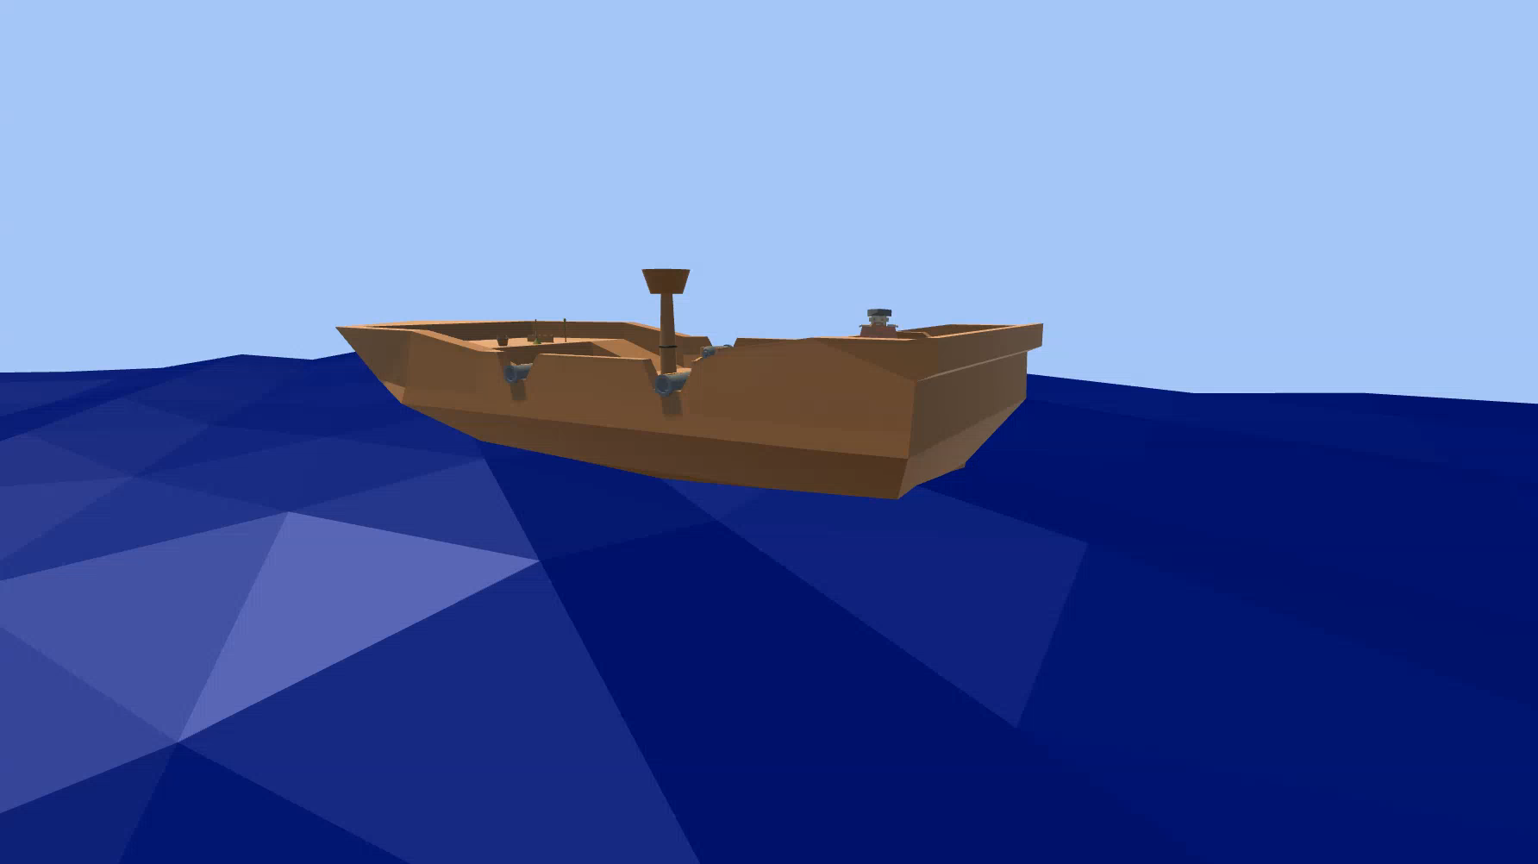
Whale Event

Slide 12
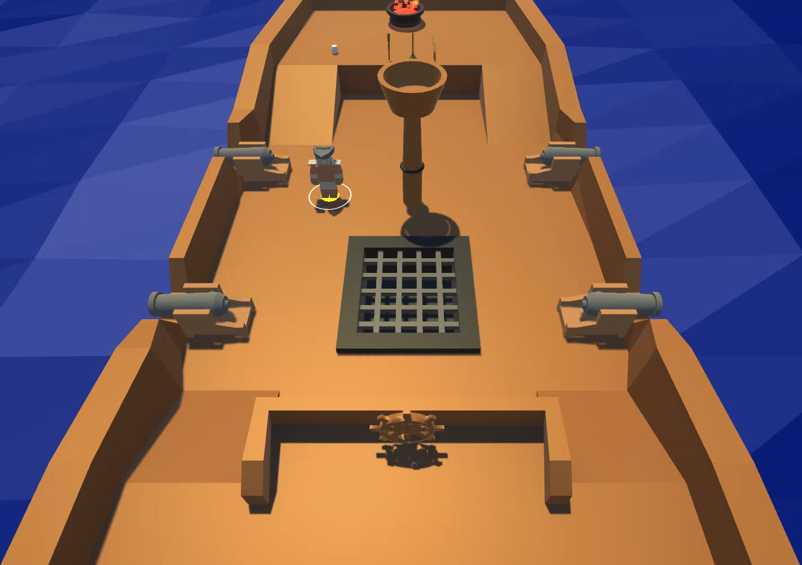
Seagull

Slide 13
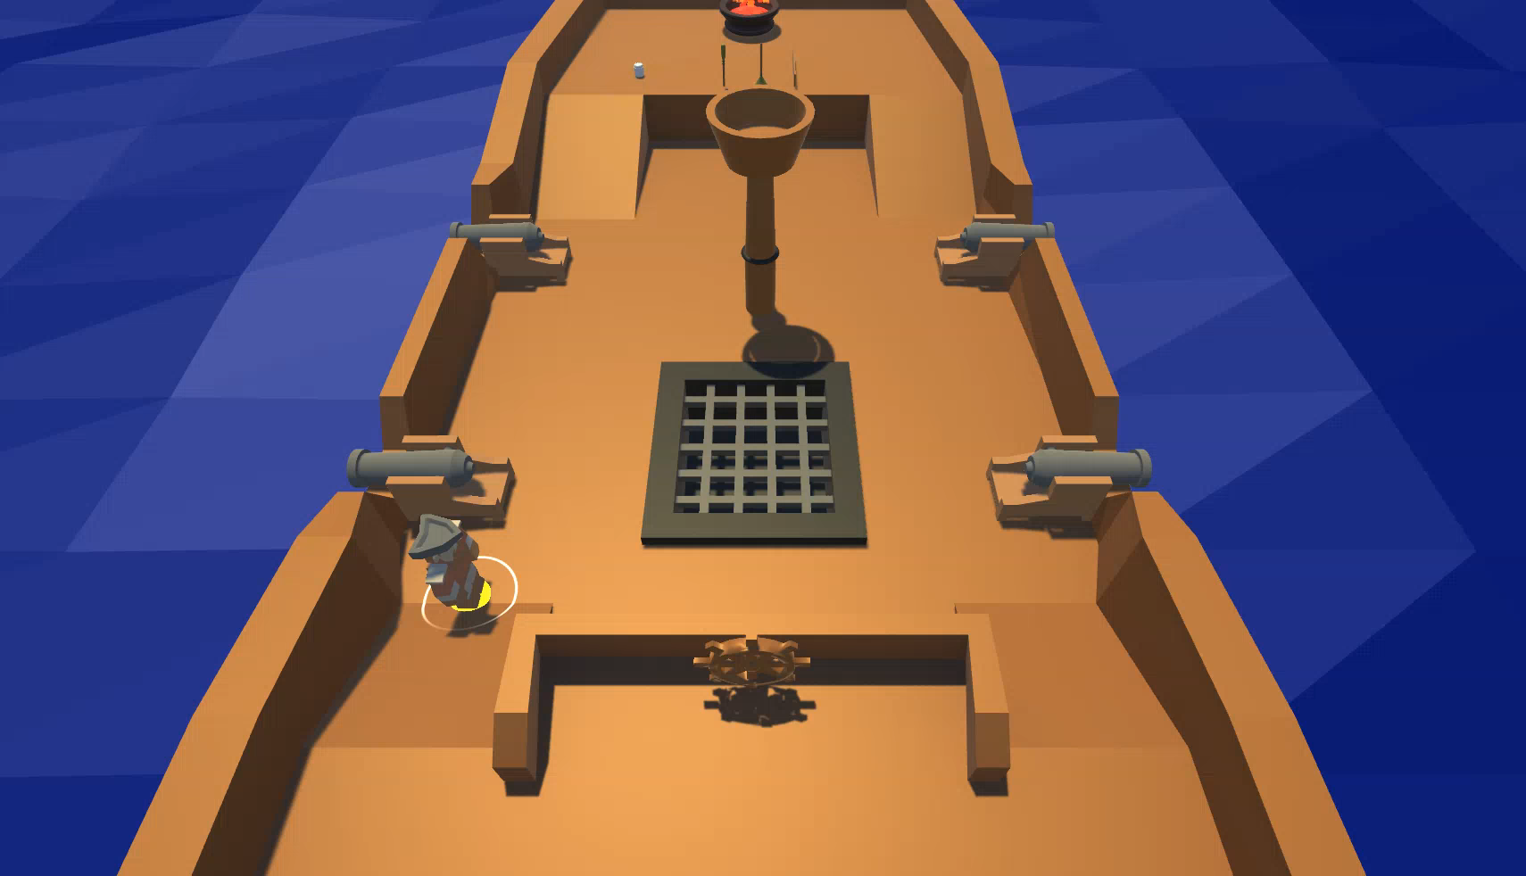
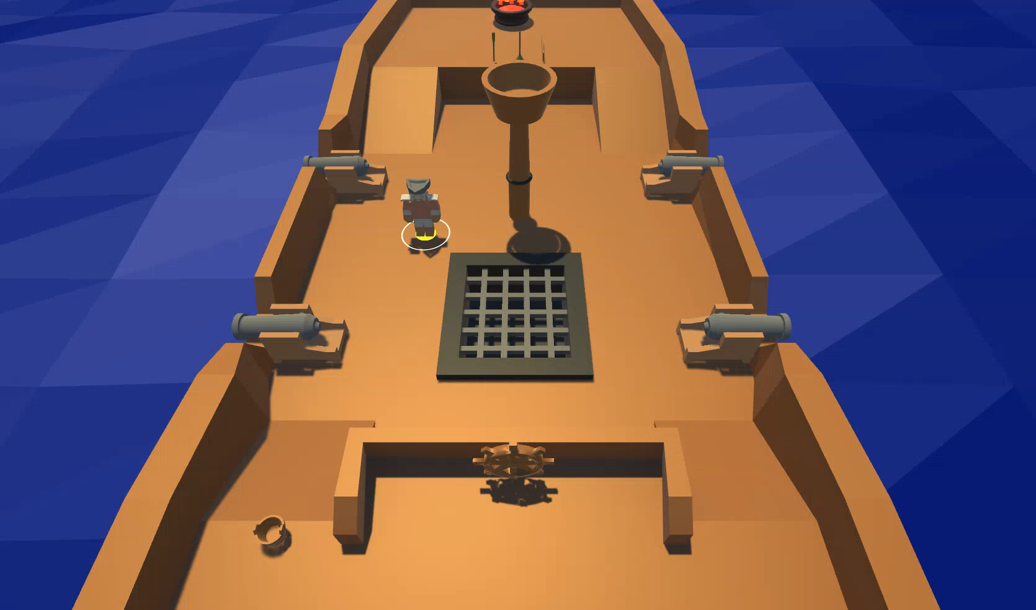
Steering the Ship

Slide 14
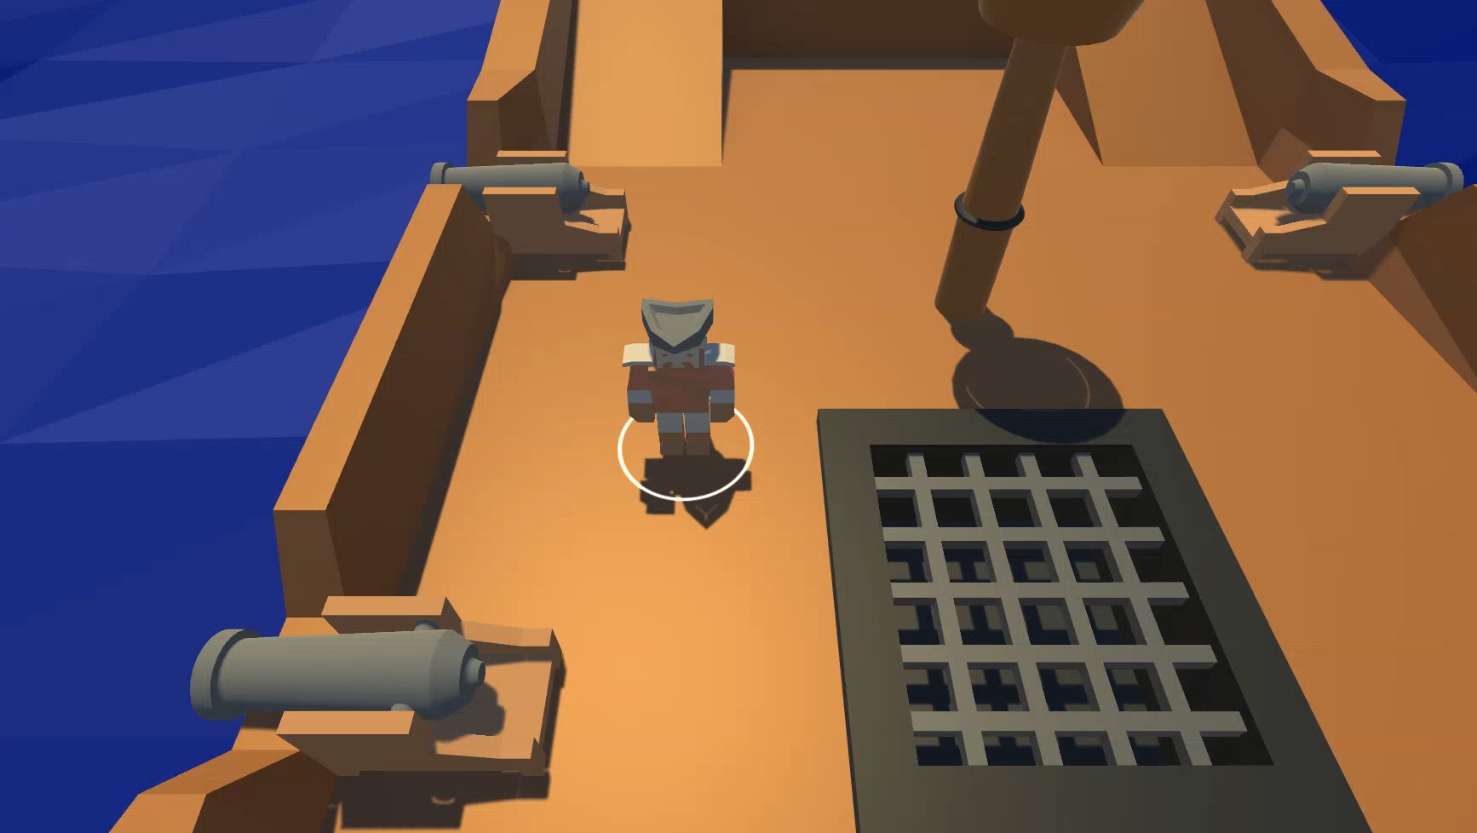
Timer UI

Slide 15
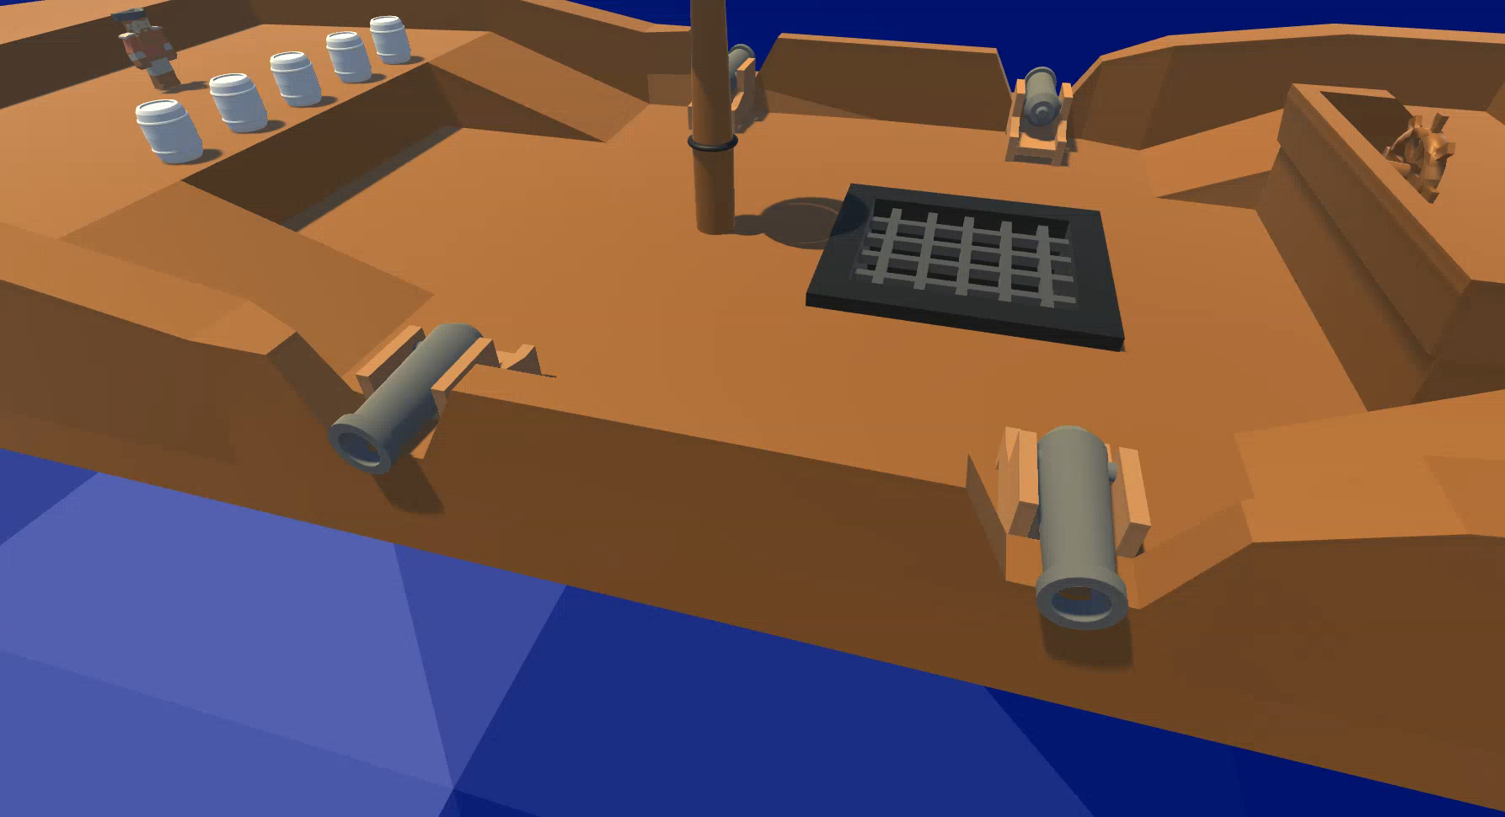
Water Level

Slide 16
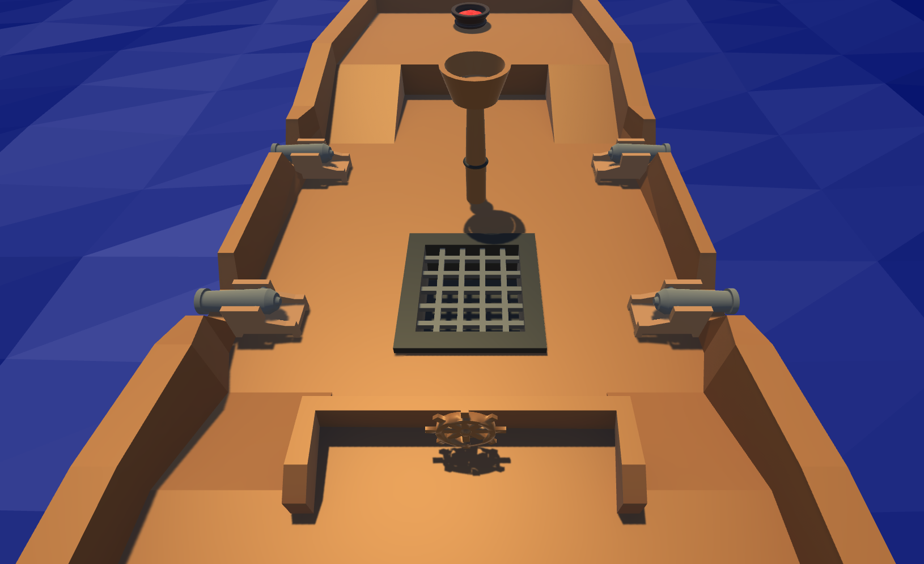
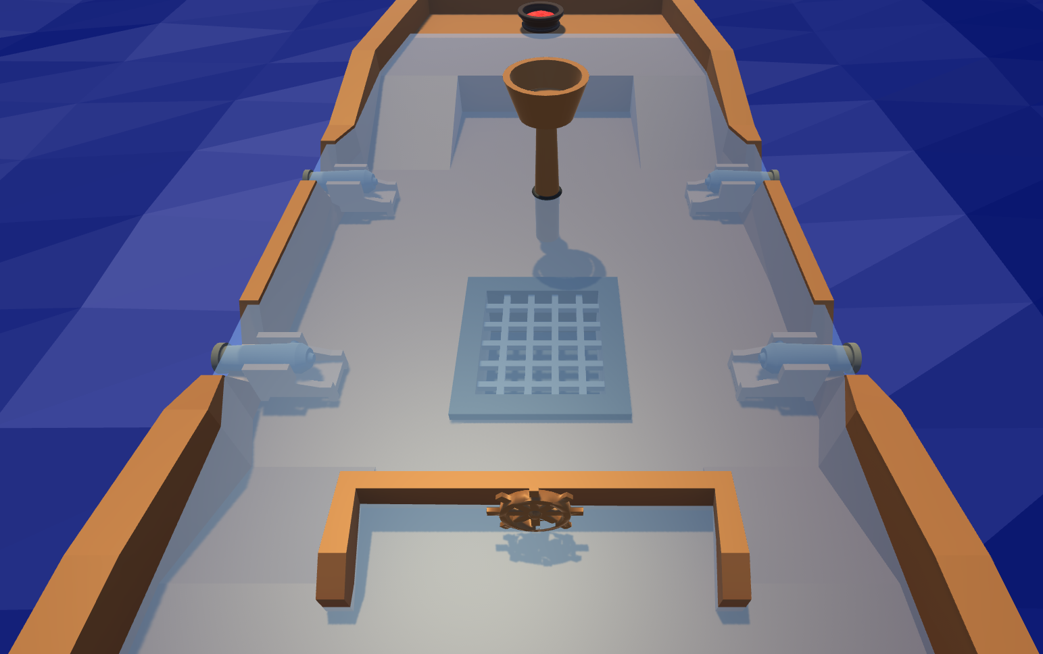
Telegraphing Ship Health

Slide 17
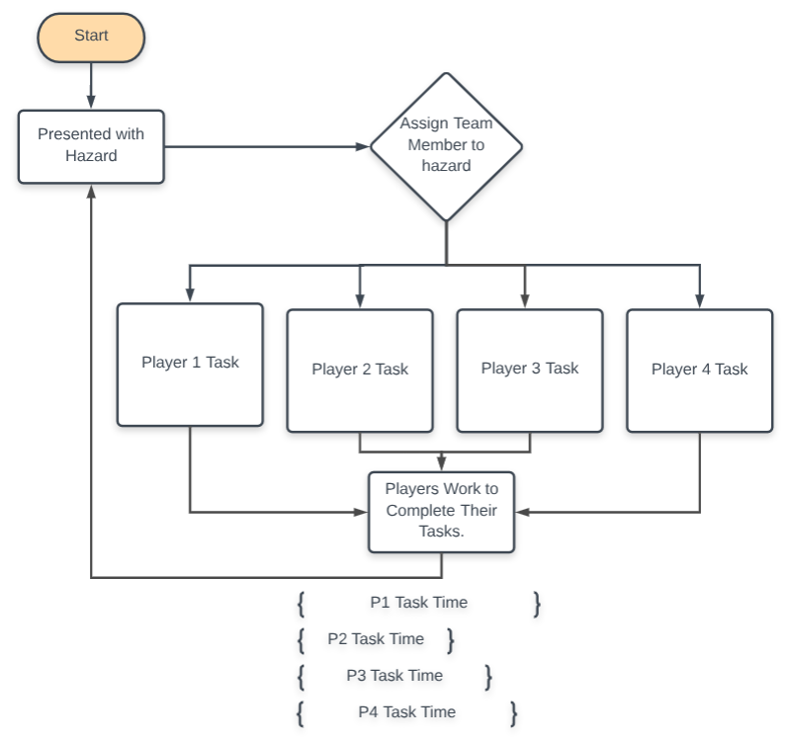
Flow Chart

Slide 18
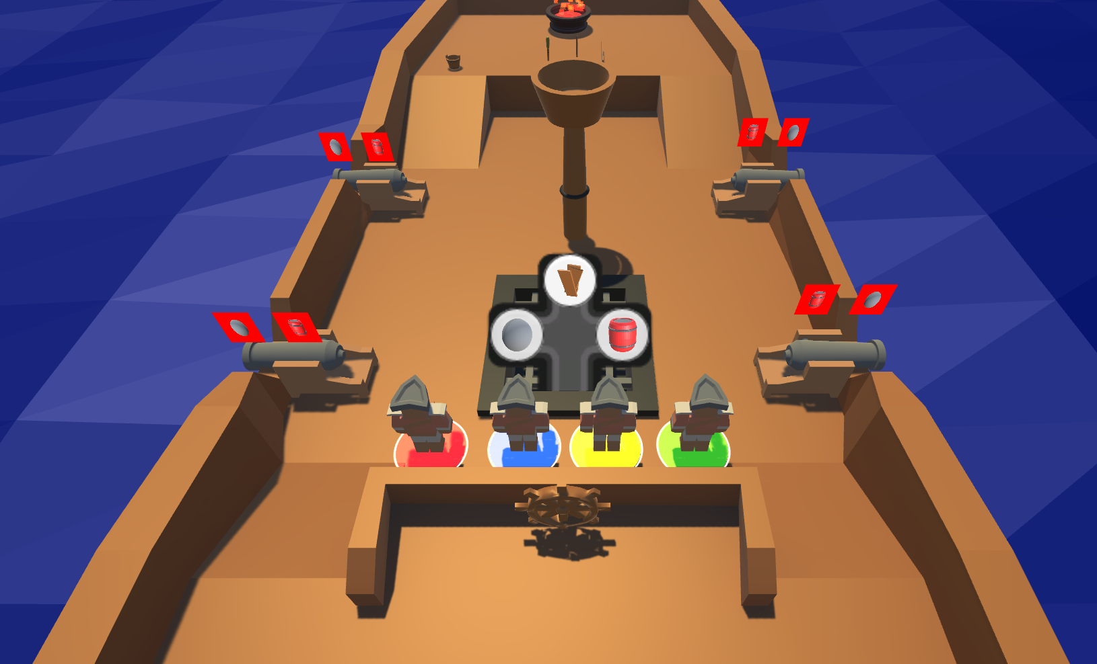
Gameplay: Start

Slide 19
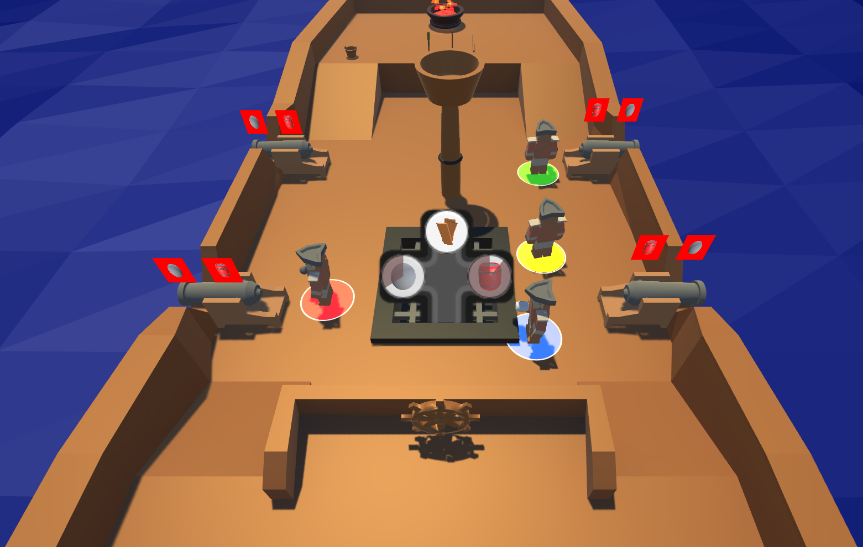
Gameplay: 5 Seconds

Slide 20
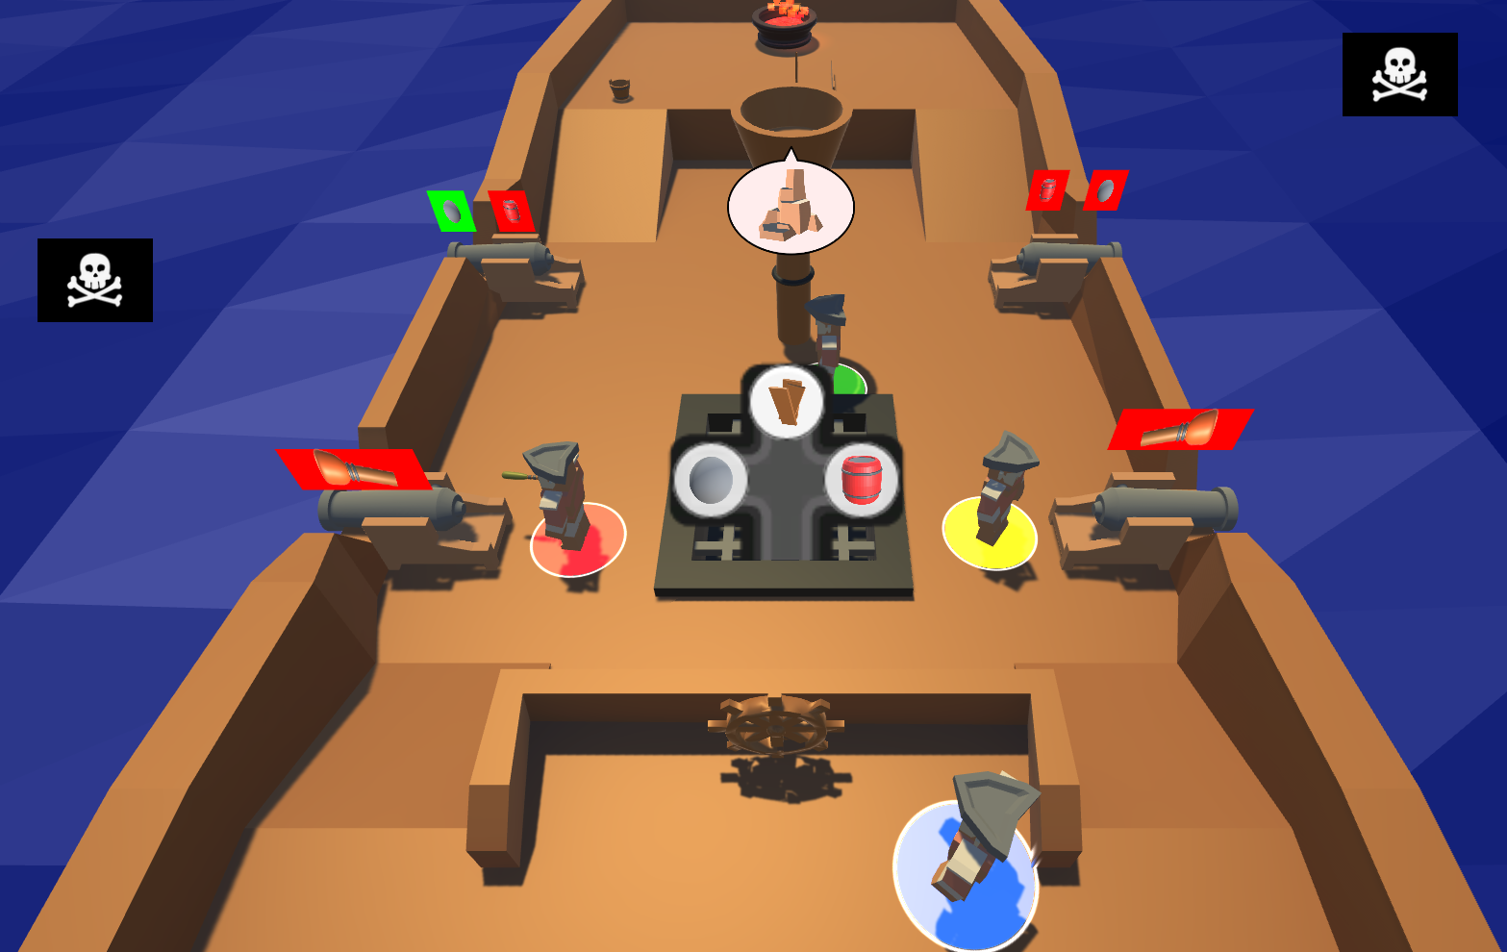
Gameplay: 20 Seconds

Slide 21
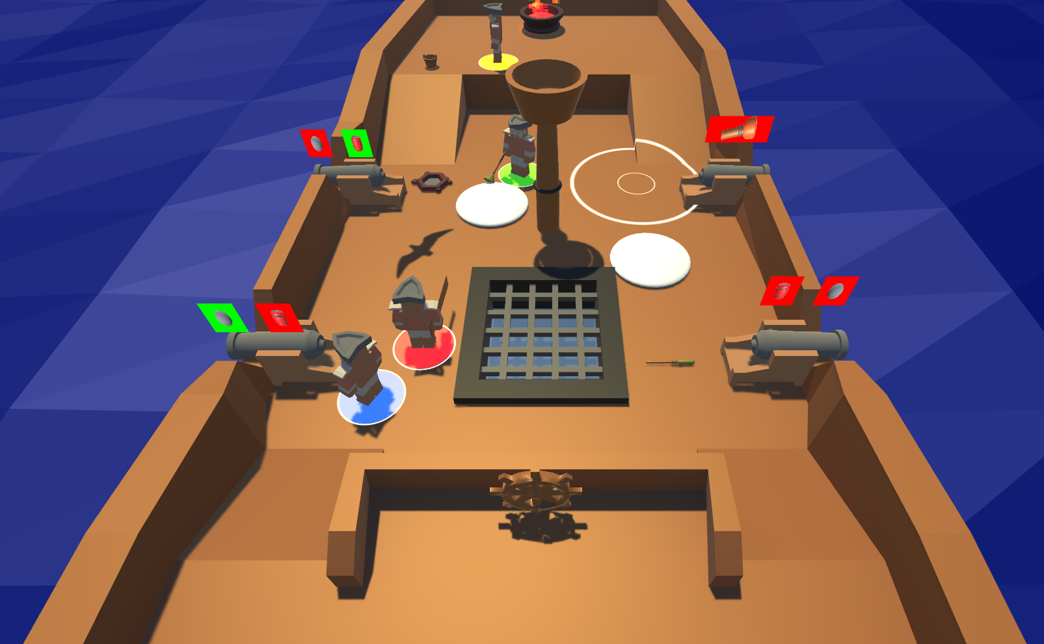
Gameplay: 40 Seconds

Slide 22
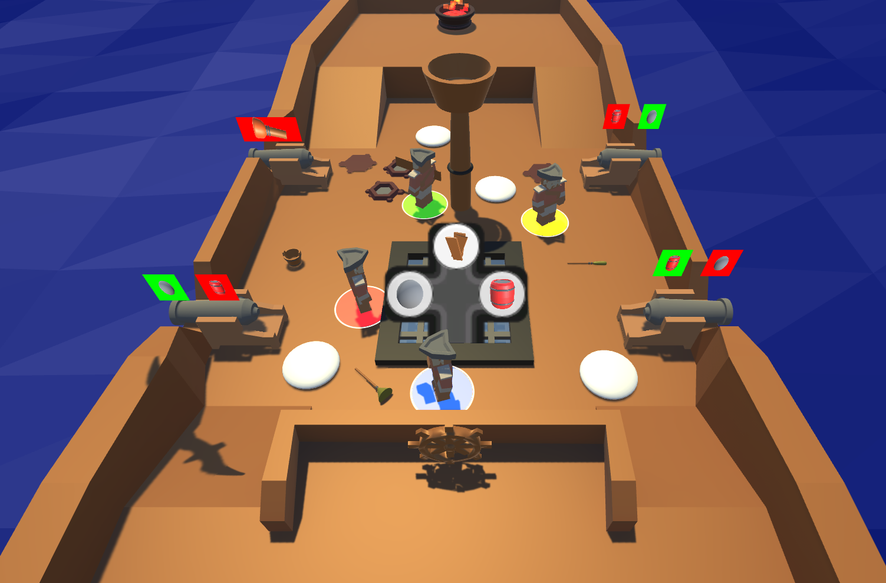
Gameplay: 1 Minute

Slide 23
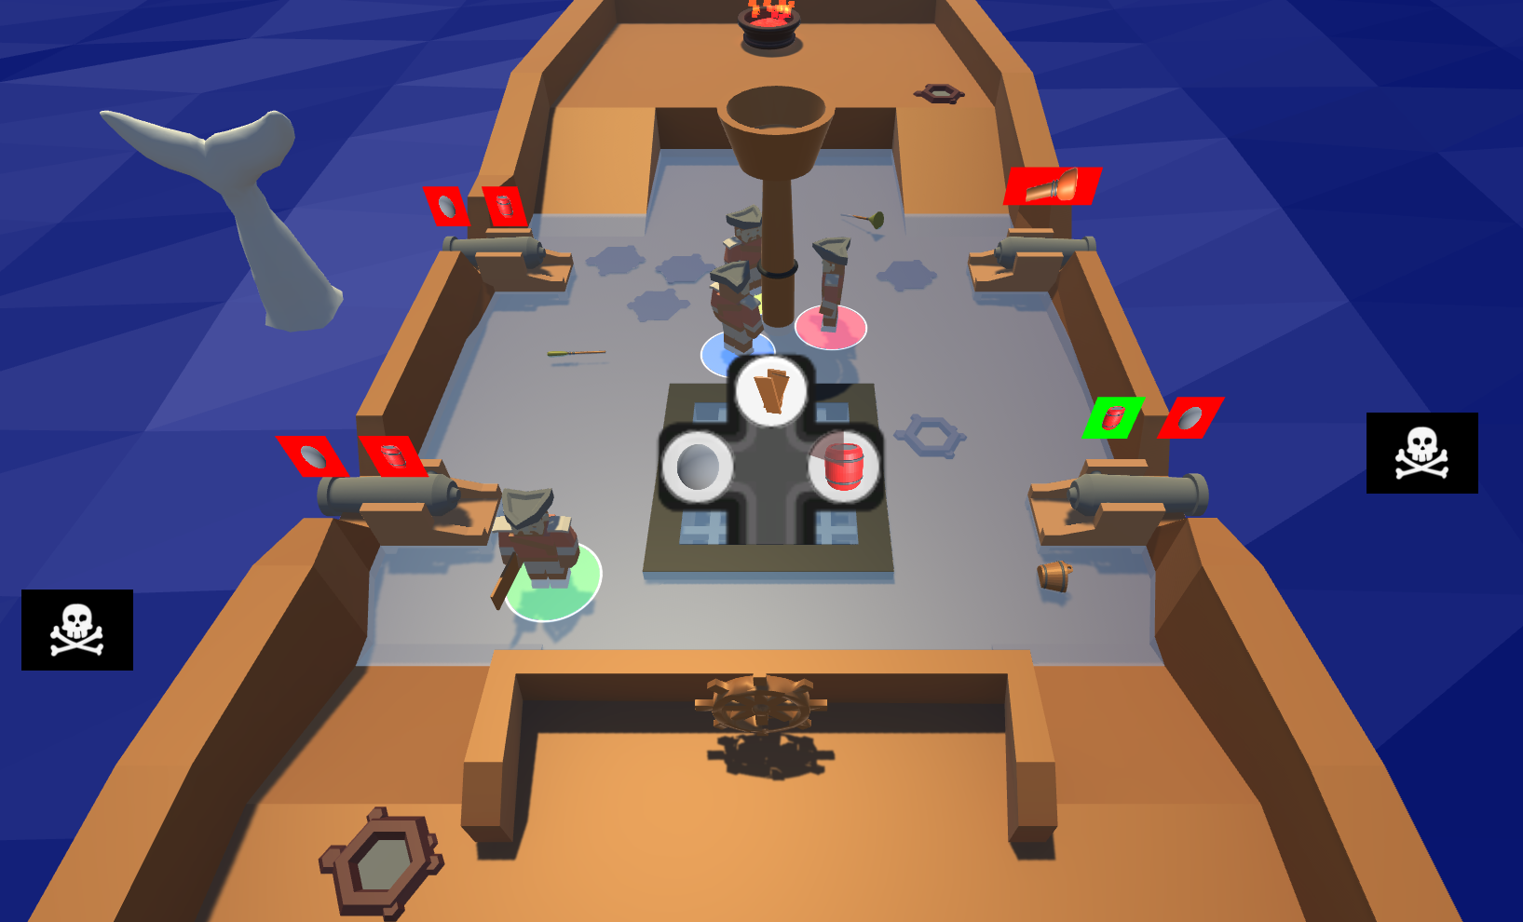
Gameplay: 2 Minutes

Slide 24
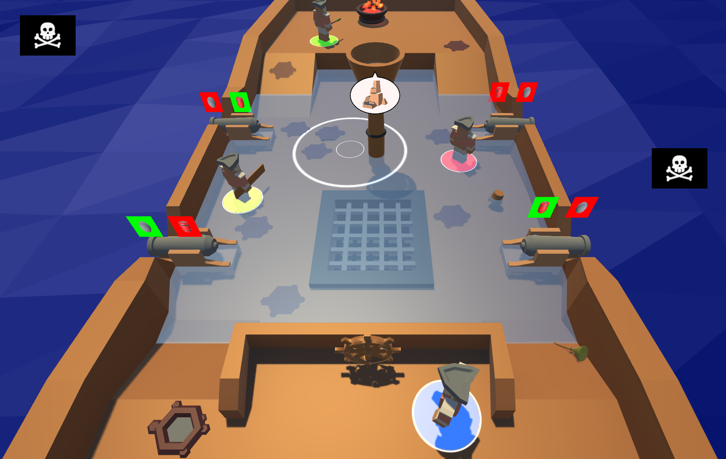
Gameplay: 4 Minutes

Slide 25
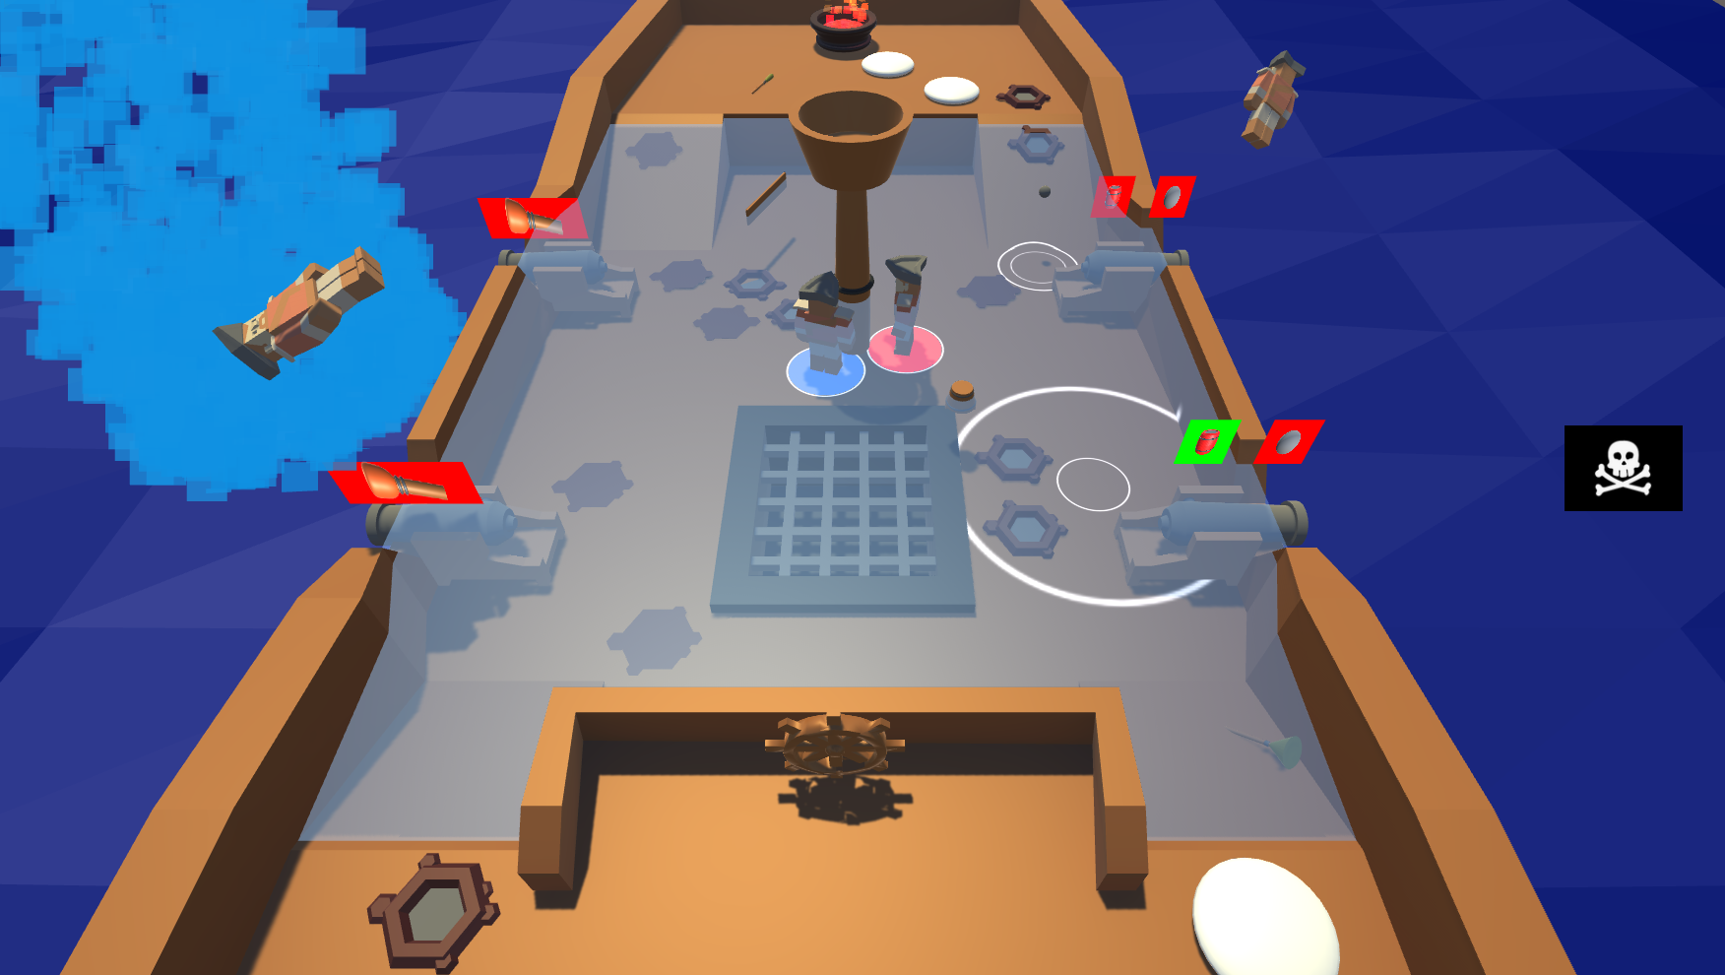
Gameplay: 5 Minutes

Slide 26
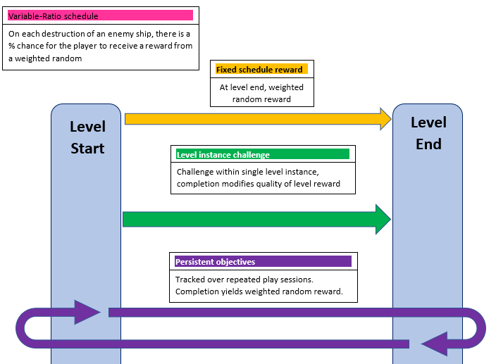
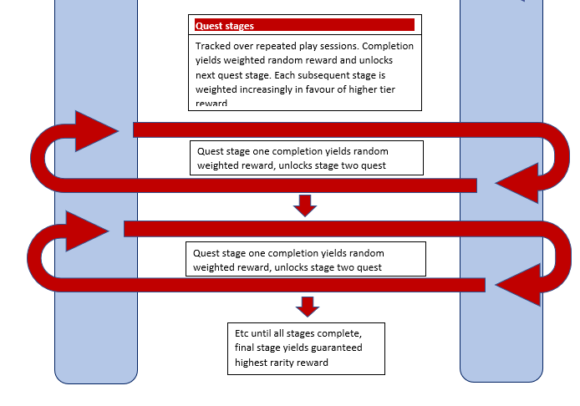
Reward Schedules

Slide 27
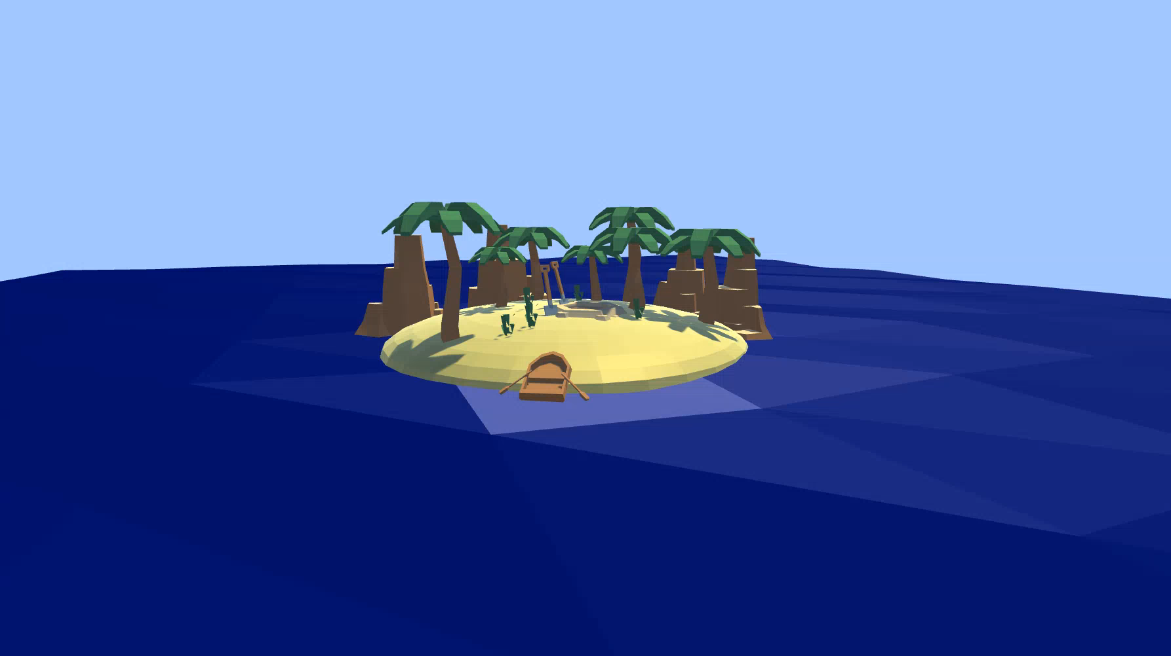
Rewards Animation

Slide 28
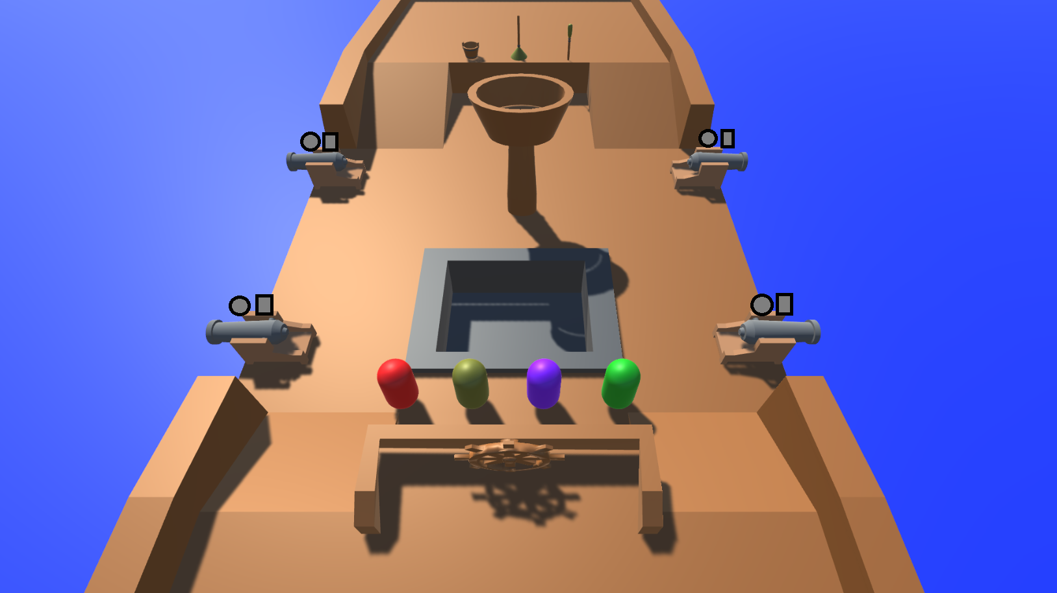
How the Game Has Developed
Updated mechanics
All mechanics implemented (independently)
Animation sequence
Updated existing assets
Implemented assets for new mechanics

Slide 29

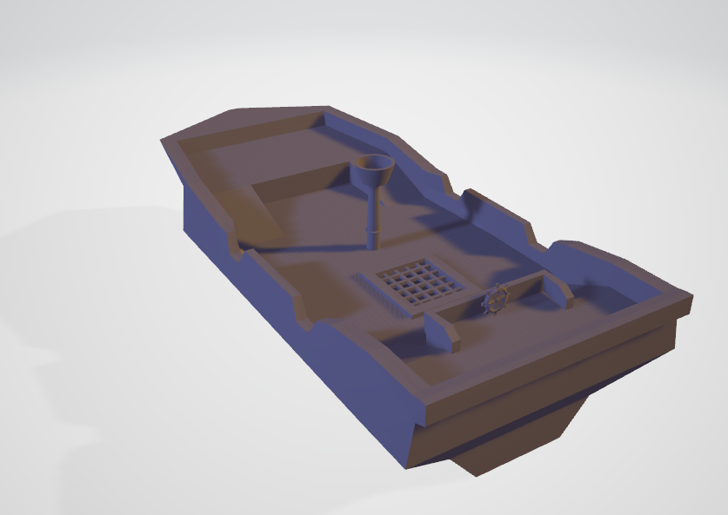
Work Completed
TOTAL (OVER 4 WEEKS)
Tom: 51hours 35minutes
Henry: 47hours 25minutes
Difference can be put down to Player UI task + production of 3D models/animations.

Slide 30
Plan for Christmas Vacation
Collate work into the Main Scene - ensure all compatible, bug free
Game managers
Be in position for playtesting
Once achieved can implement TUTORIAL / ‘saving’ / customisation / character select / rewards / quests

Slide 31
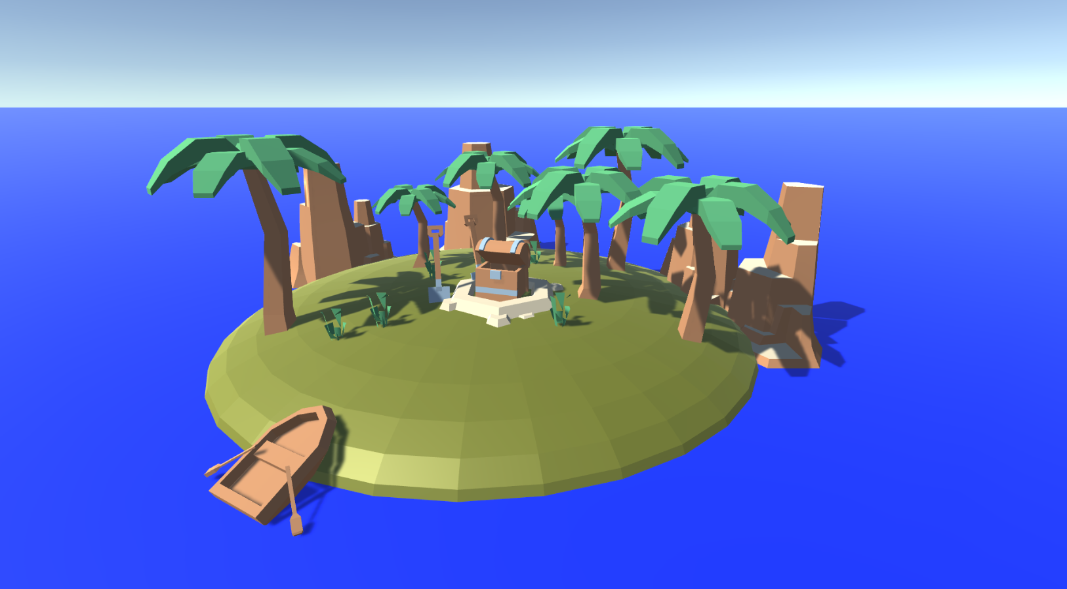
Questions?

